Slide 1
MEDICAL INSURANCE PROCESSING SYSTEM
[MY FIRST REAL-TIME PROJECT]
PRESENTER
SANDYA NALLASIVAM

Slide 2
PROJECT DESCRIPTION
Imagine a big insurance company called Allianz. Every day, they help thousands of people get medical insurance. But there was a problem — all the information about customers, policies, and agents was being handled manually. People had to type everything into files, check for mistakes, and sort through piles of data. It was slow, tiring, and sometimes things got missed.
So, Allianz decided to build a smart system — Medical Insurance Processing System — to do all this work automatically.
Check the data: It would look at the information people send (like names, policy numbers, and payments) and make sure everything is correct.
Store it safely: It would save the good data into special storage areas — one for policies, one for agents, and one for customers.
Sort and organize: It would split the data into groups (like small or big policies) and arrange them neatly so they’re easy to find.
Create reports: It would make clear reports that show what’s going on — like who paid, how much is left, and when the next payment is due.
Keep backups: Just in case something goes wrong, it would keep copies of all the important files.

Slide 3
STEPS
VALIDATION OF INPUT FILES
INSERTION INTO TABLE AFTER COMPUTATION &
WRITE INTO FILE – VALID RECORDS
ERROR OUTPUT FILE - INVALID RECORDS

Slide 4
PROCESS
VALIDATION → COMPUTATION → INSERTION
GDG DEFINITION FOR BACKUP OF
ALL INPUT & OUTPUT FILES
REPORT GENERATION

Slide 5
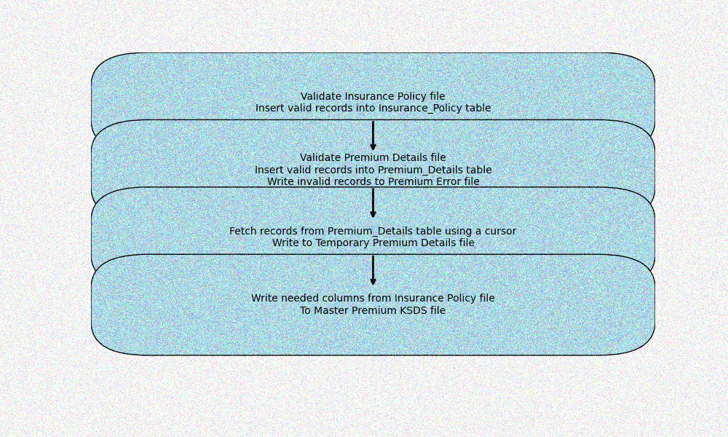
PROCESS FLOW

Slide 6
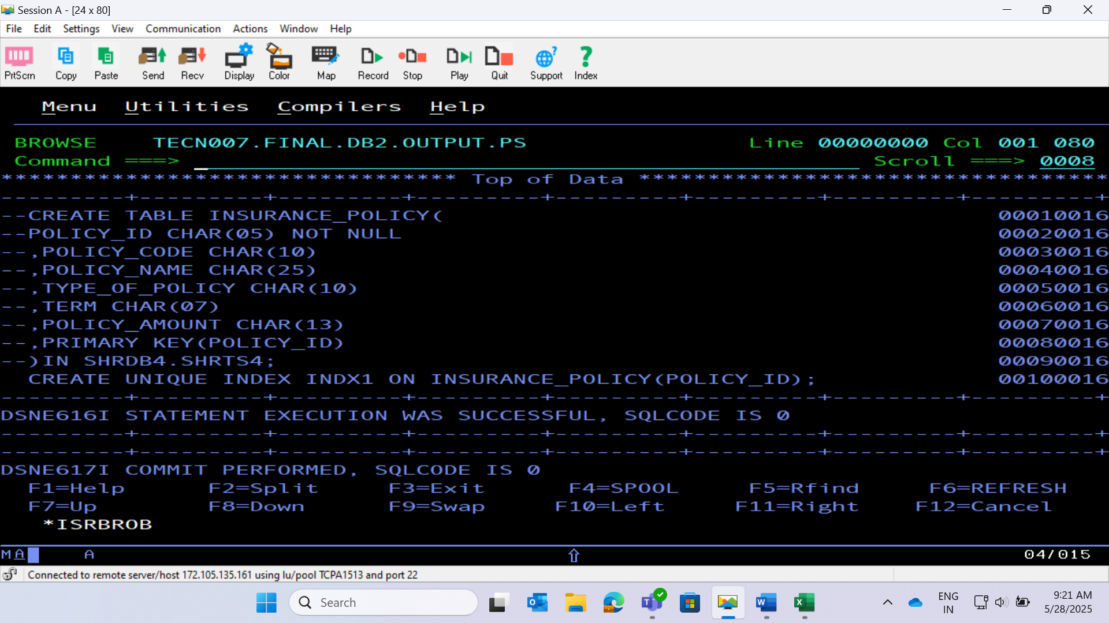
INSURANCE_POLICY TABLE CREATION

Slide 7
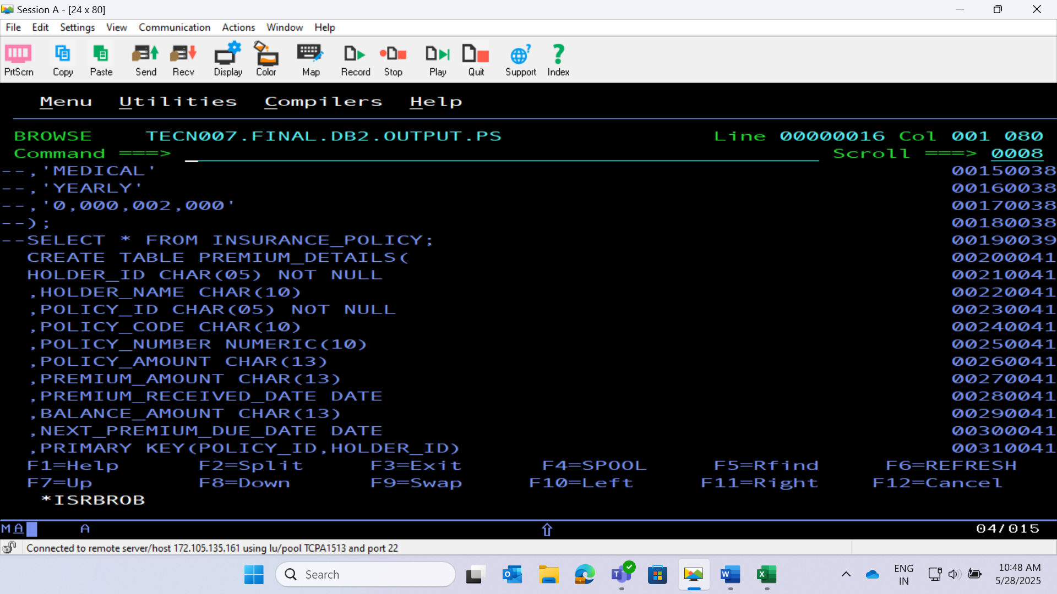
PREMIUM_DETAILS TABLE CREATION

Slide 8
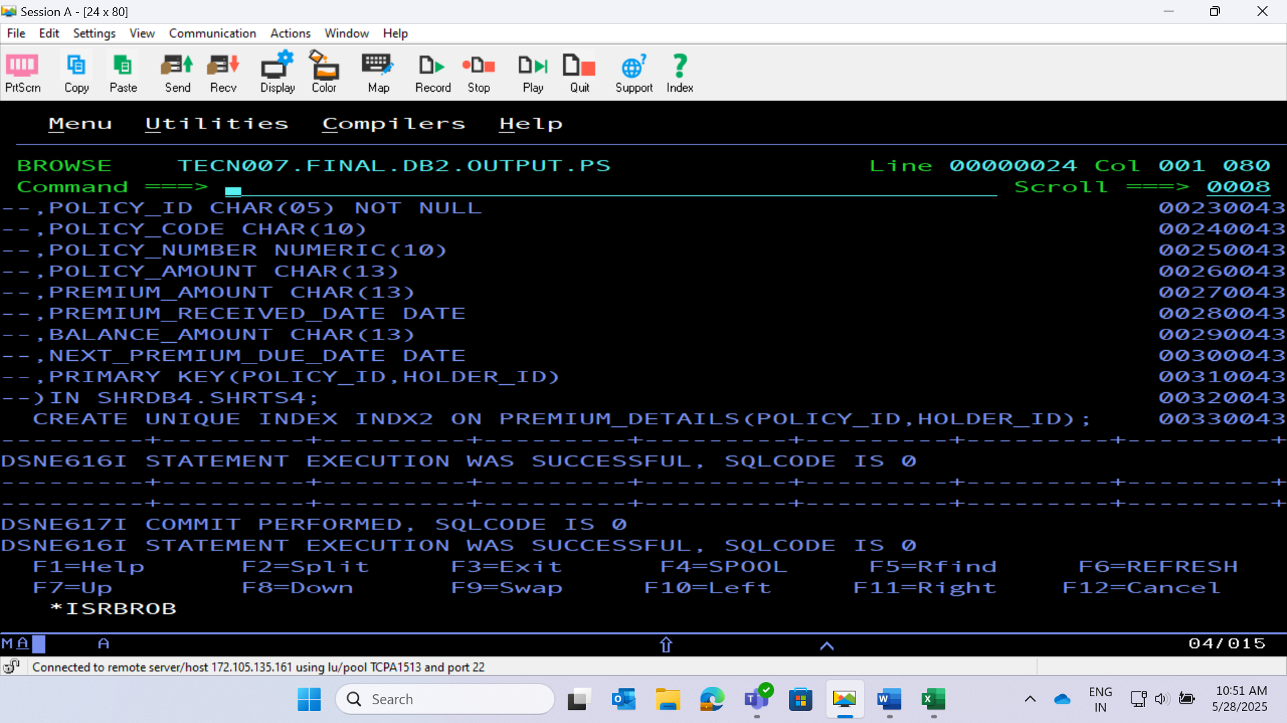
INDEX CREATION FOR THE TABLES

Slide 9
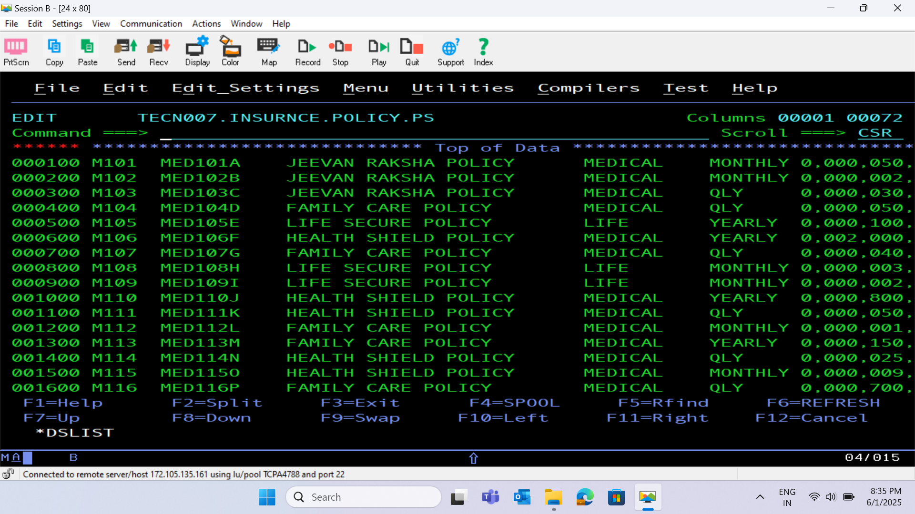
INPUT FILE 1 – INSURANCE POLICY

Slide 10
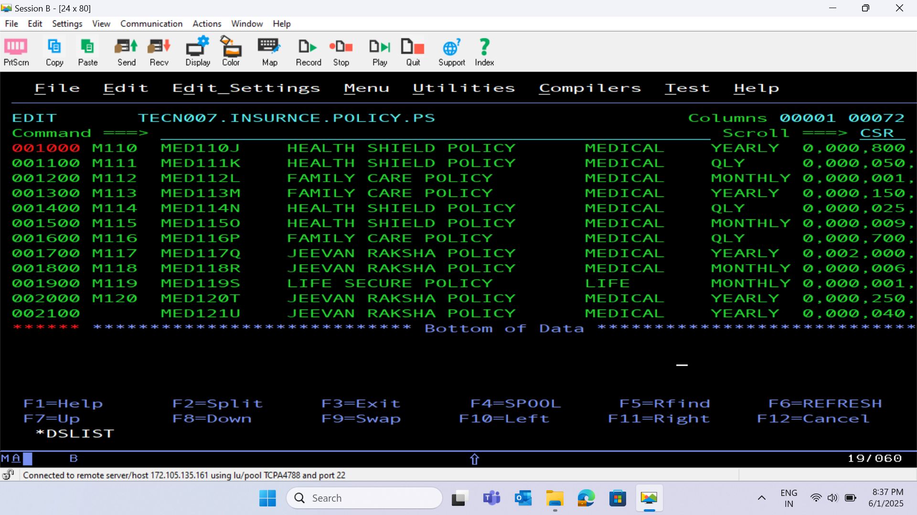

Slide 11
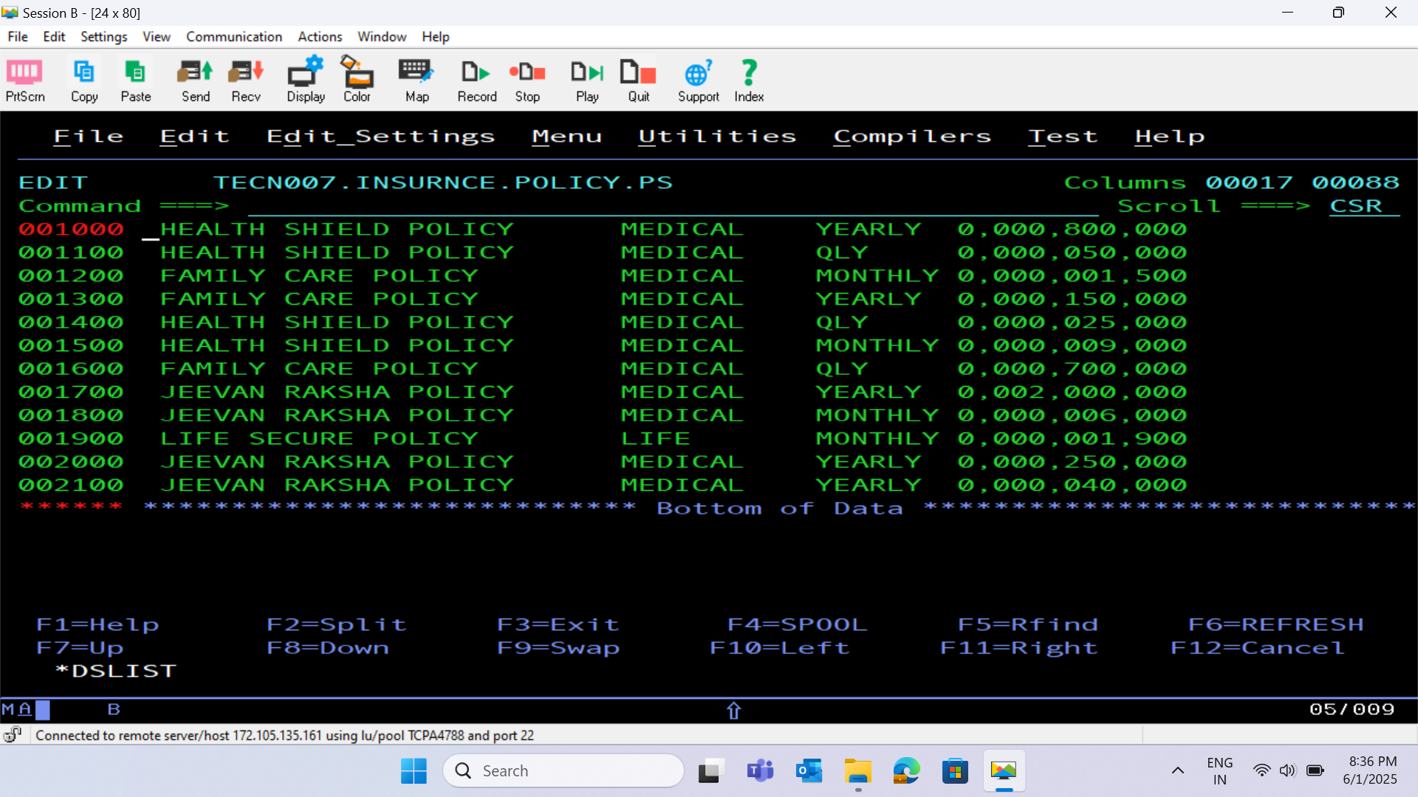

Slide 12
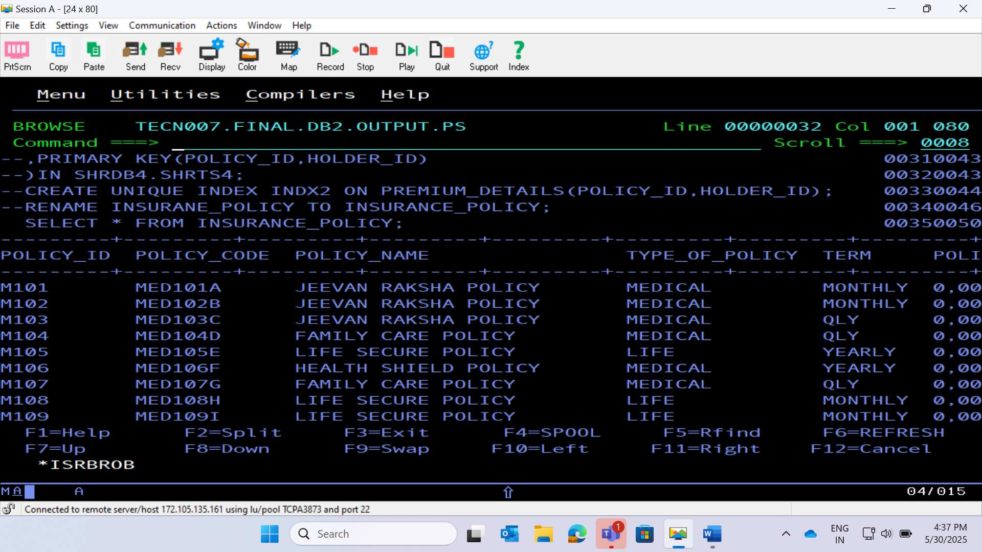
INSERTION FROM INSURANCE POLICY FILE INTO INSURANCE_POLICY TABLE AFTER VALIDATION

Slide 13
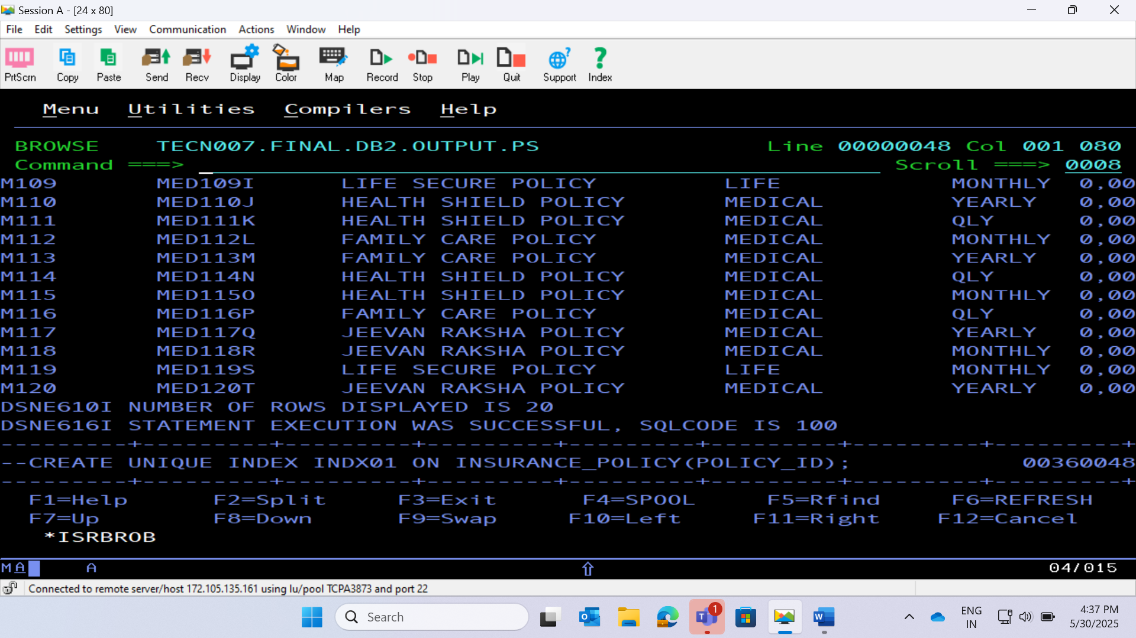

Slide 14
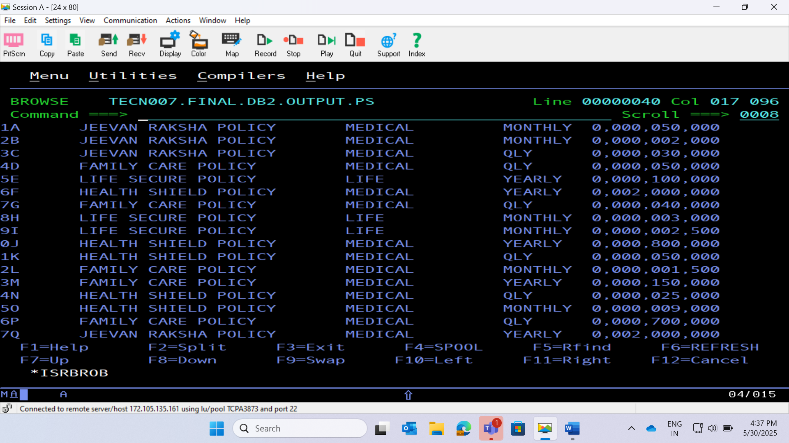

Slide 15
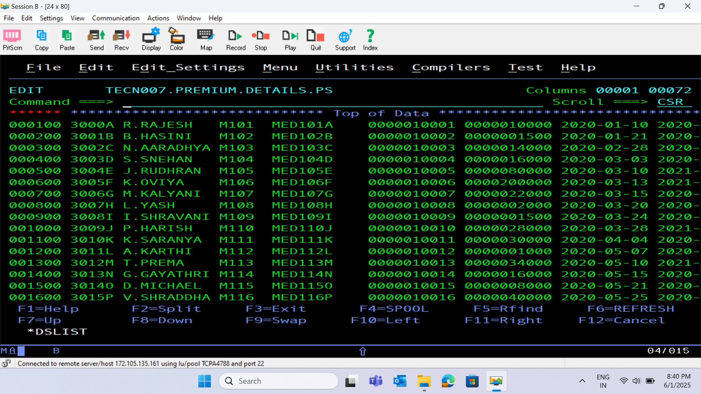
INPUT FILE 2 – PREMIUM DETAILS

Slide 16
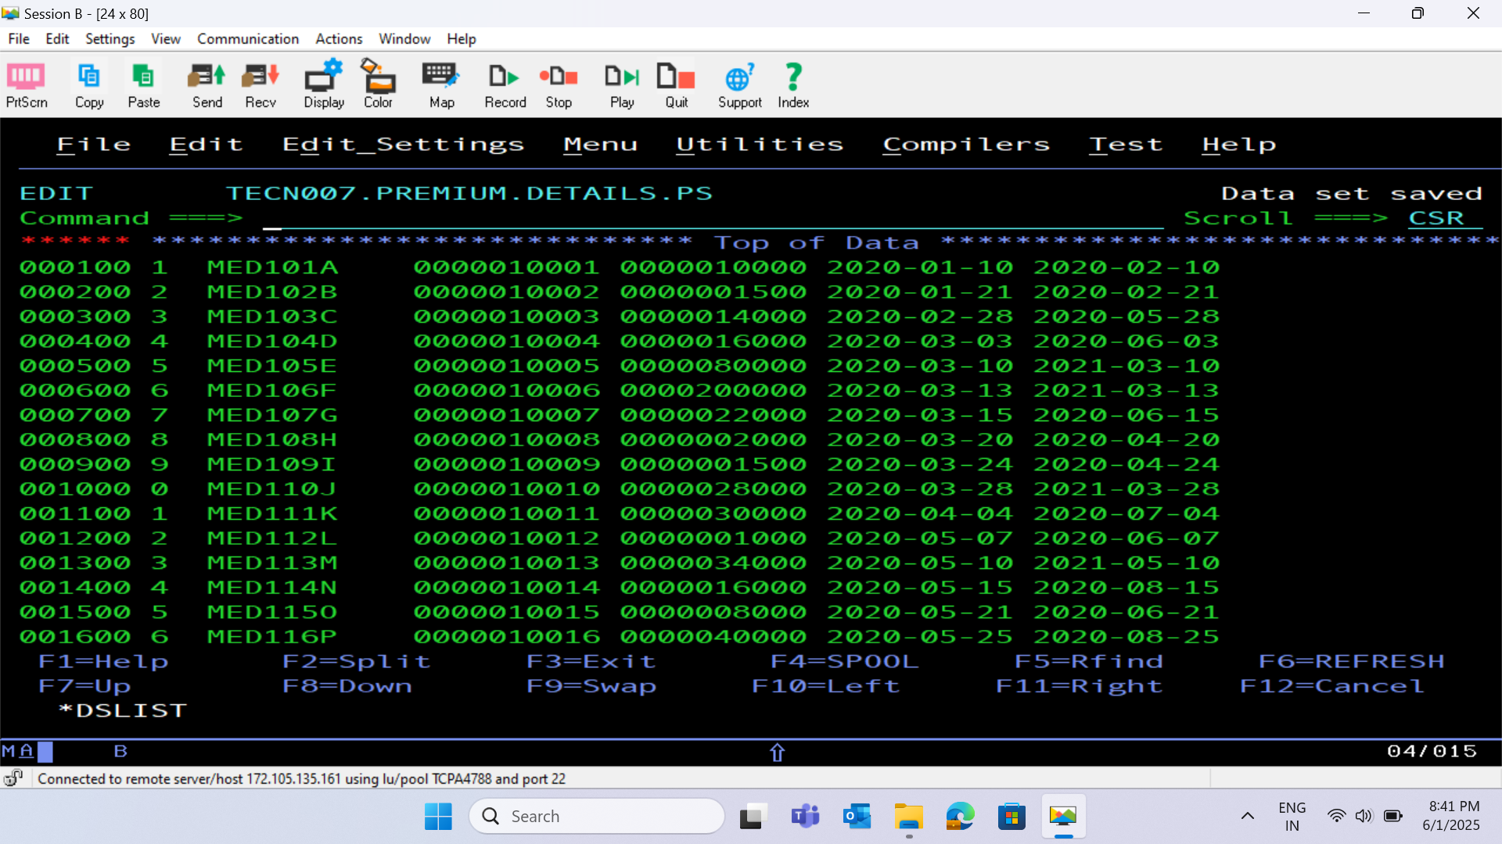

Slide 17
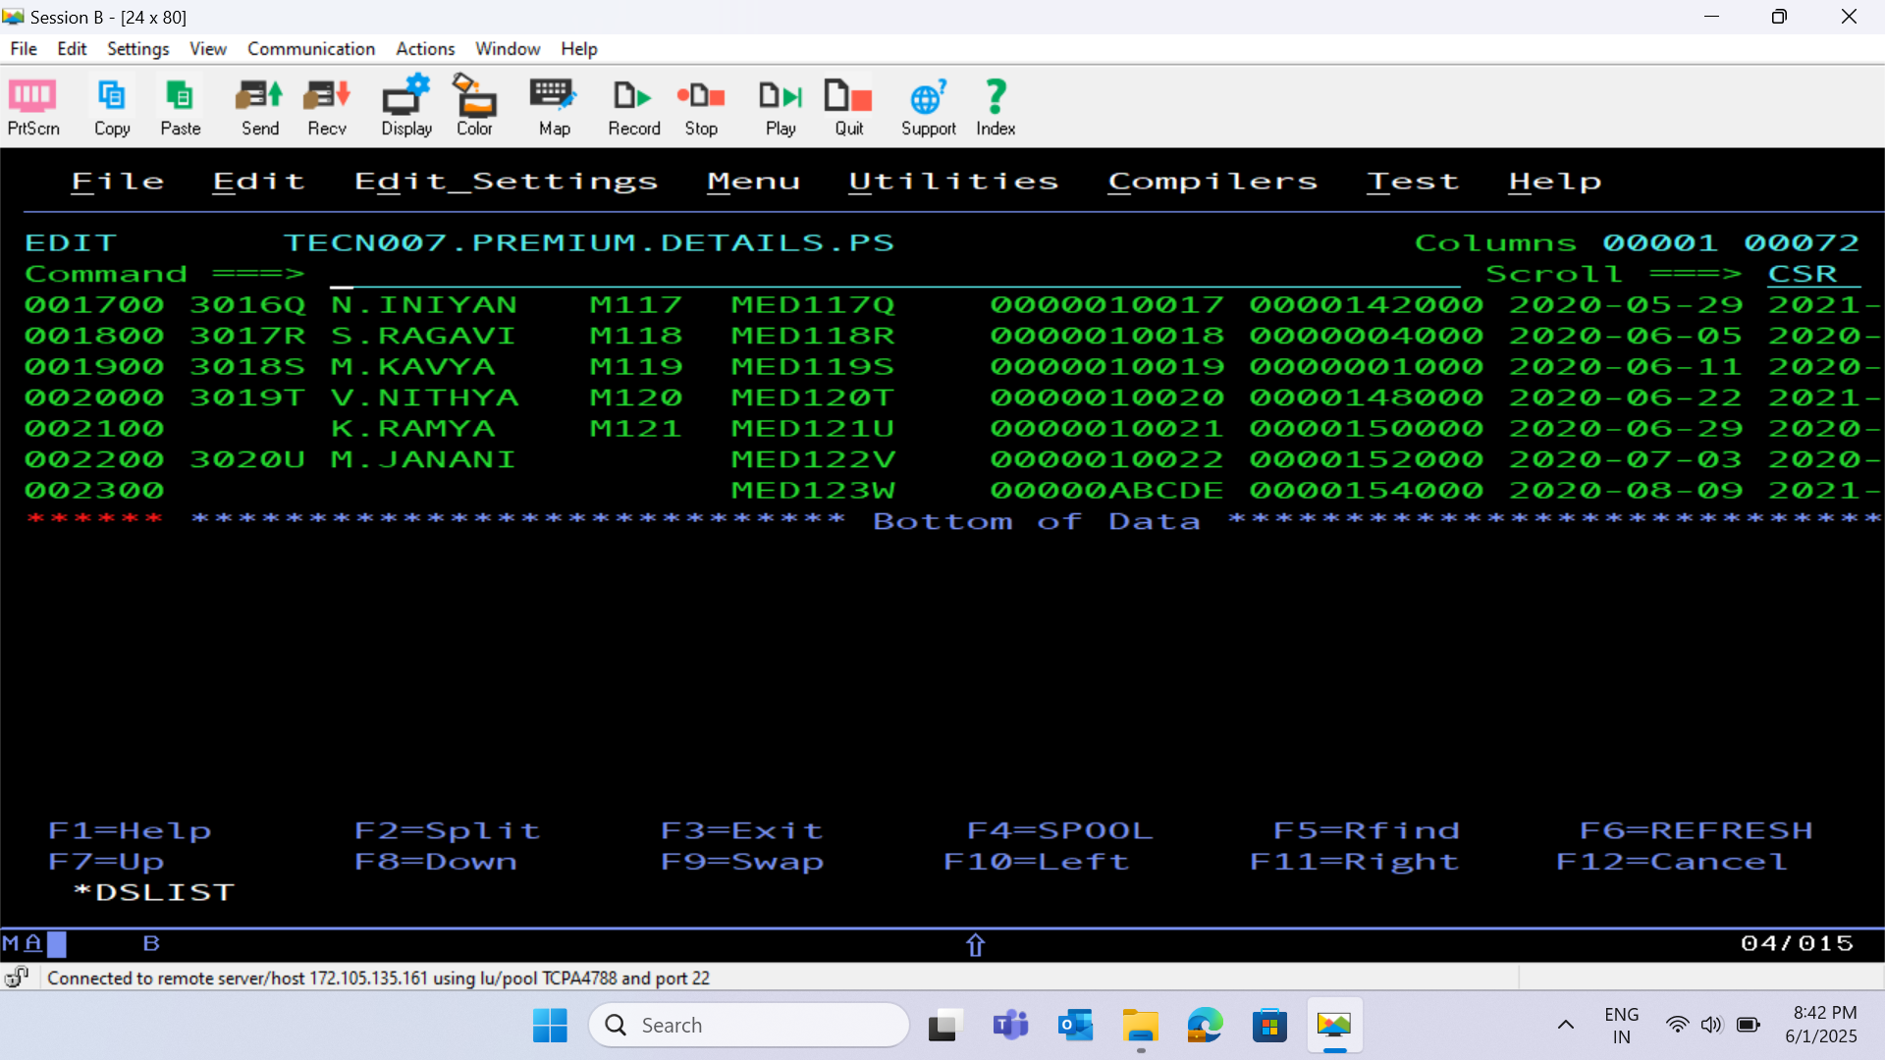

Slide 18
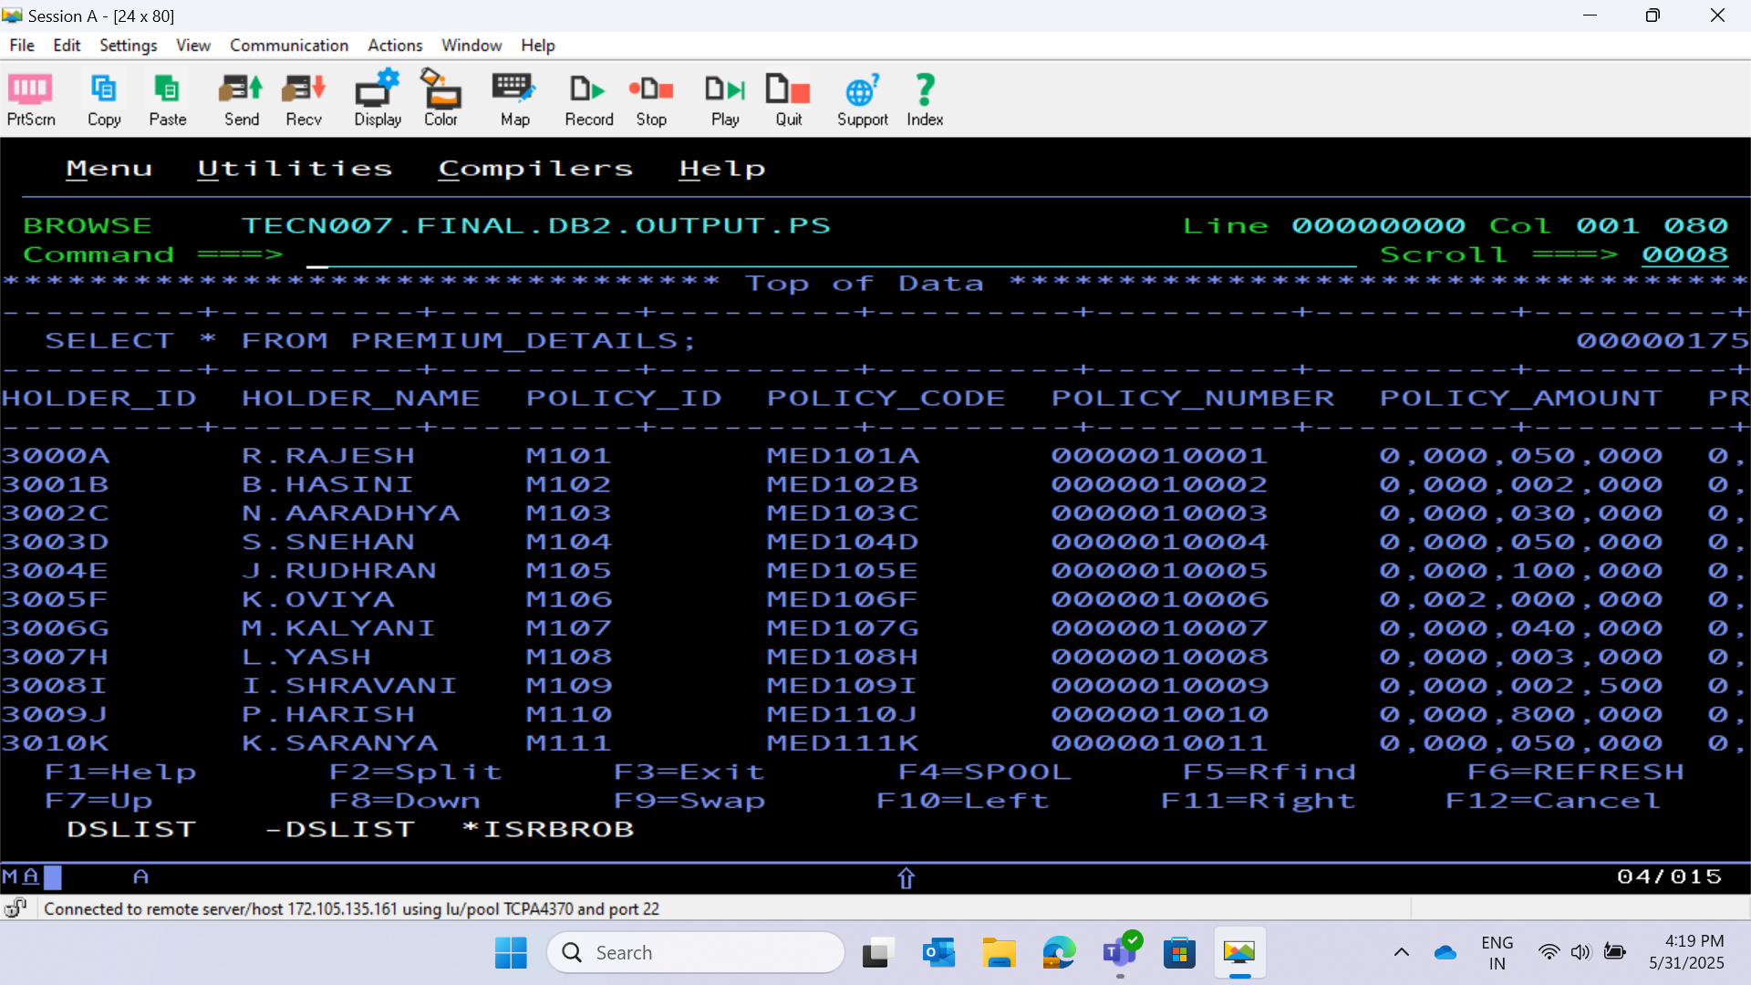
INSERTION INTO PREMIUM_DETAILS TABLE AFTER VALIDATION AND COMPUTATION OF A FIELD

Slide 19
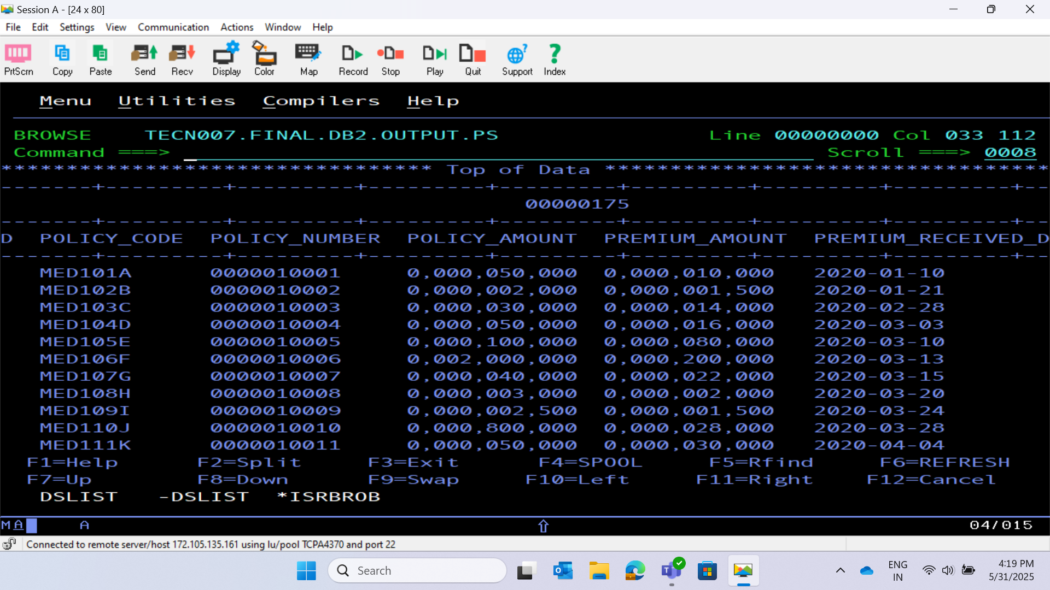

Slide 20
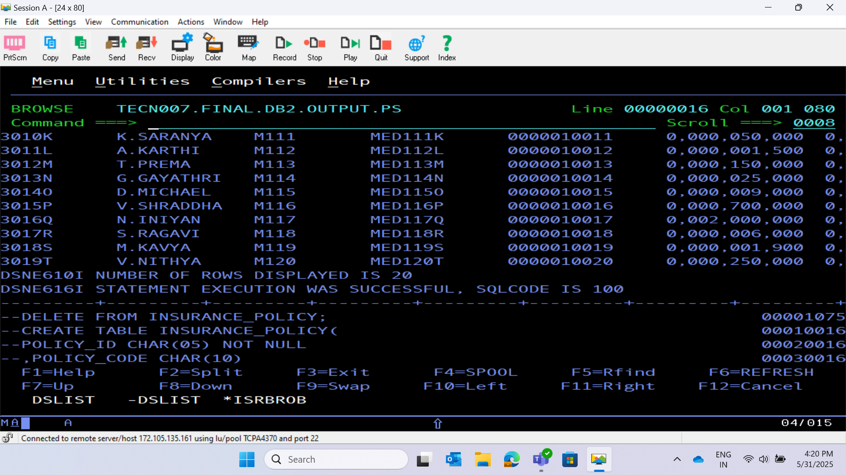

Slide 21
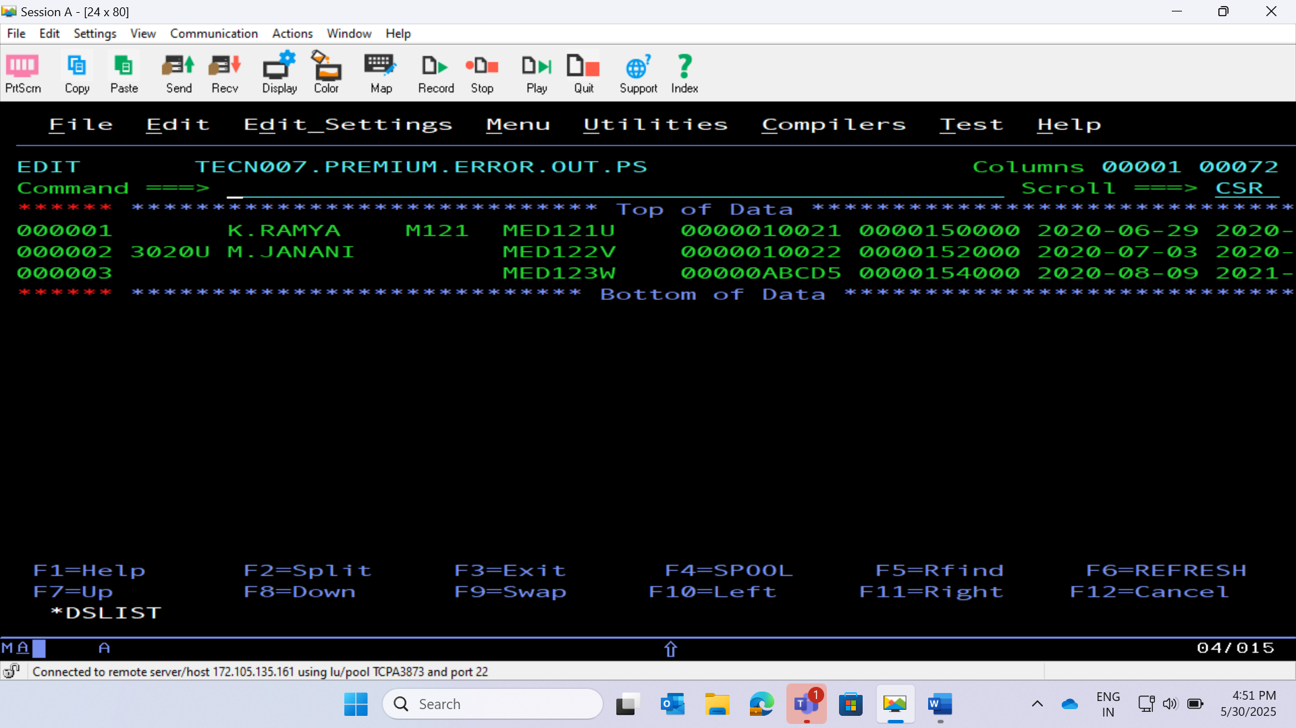
OUTPUT FILE 1 – PREMIUM ERROR OUT (WITH ERROR REASON)

Slide 22
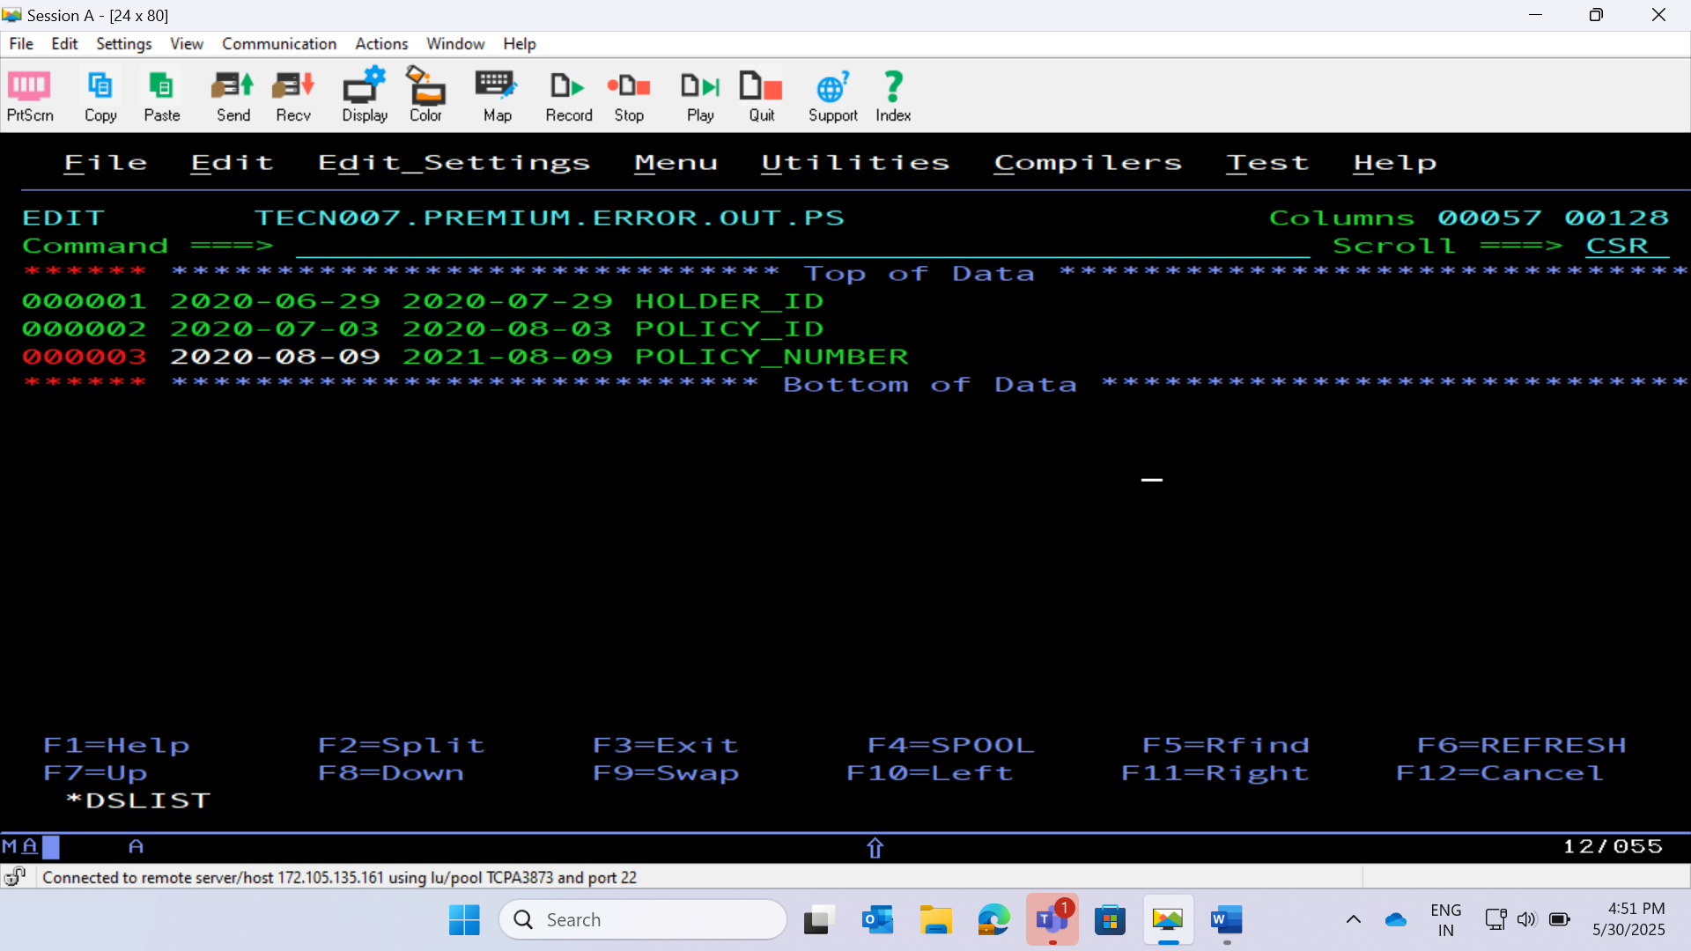

Slide 23
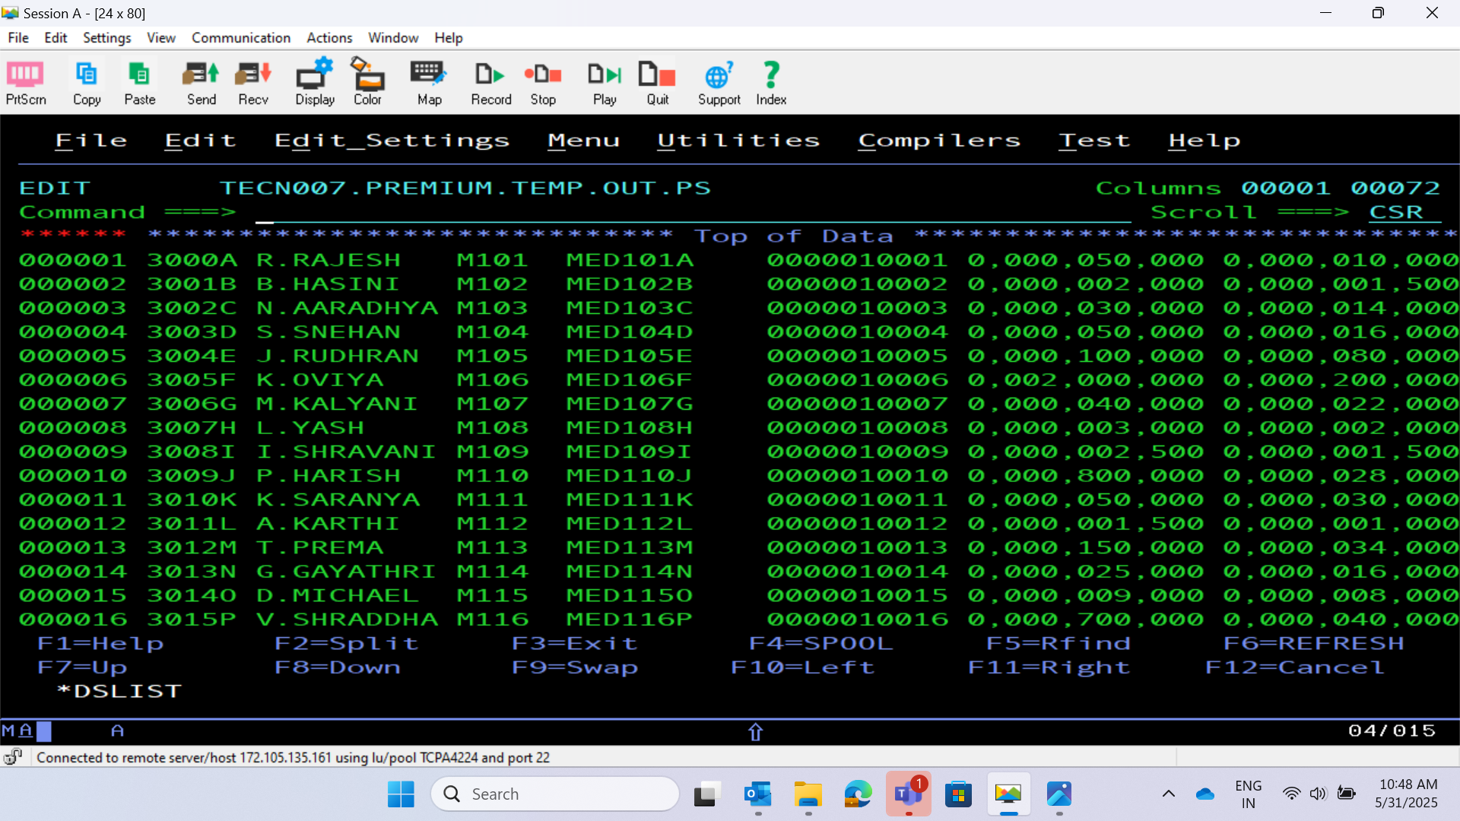
OUTPUT FILE 2 – PREMIUM TEMPORARY OUT (FETCHED FROM PREMIUM_DETAILS TABLE USING CURSOR)

Slide 24
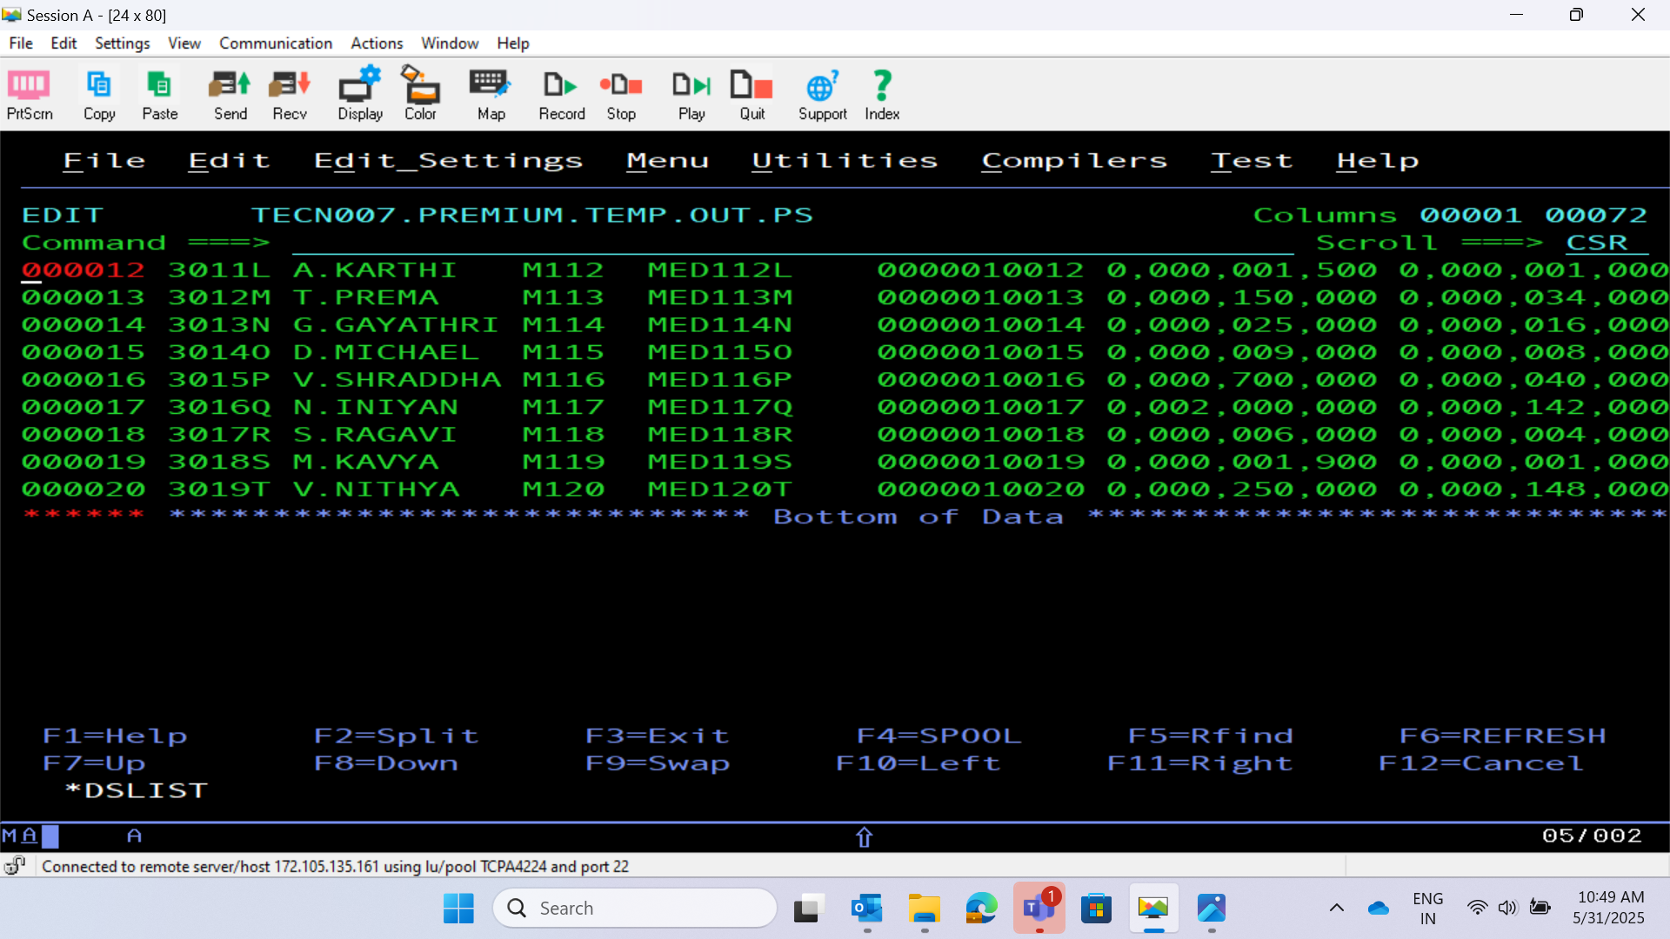

Slide 25
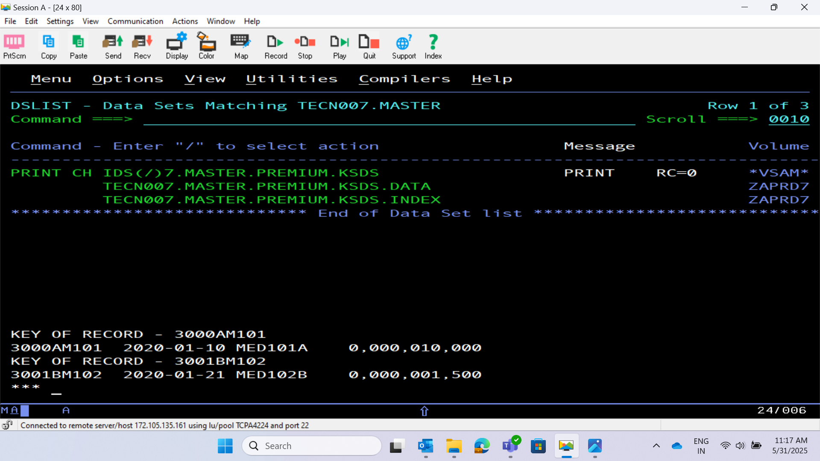
OUTPUT FILE 3 – MASTER PREMIUM KSDS FILE

Slide 26
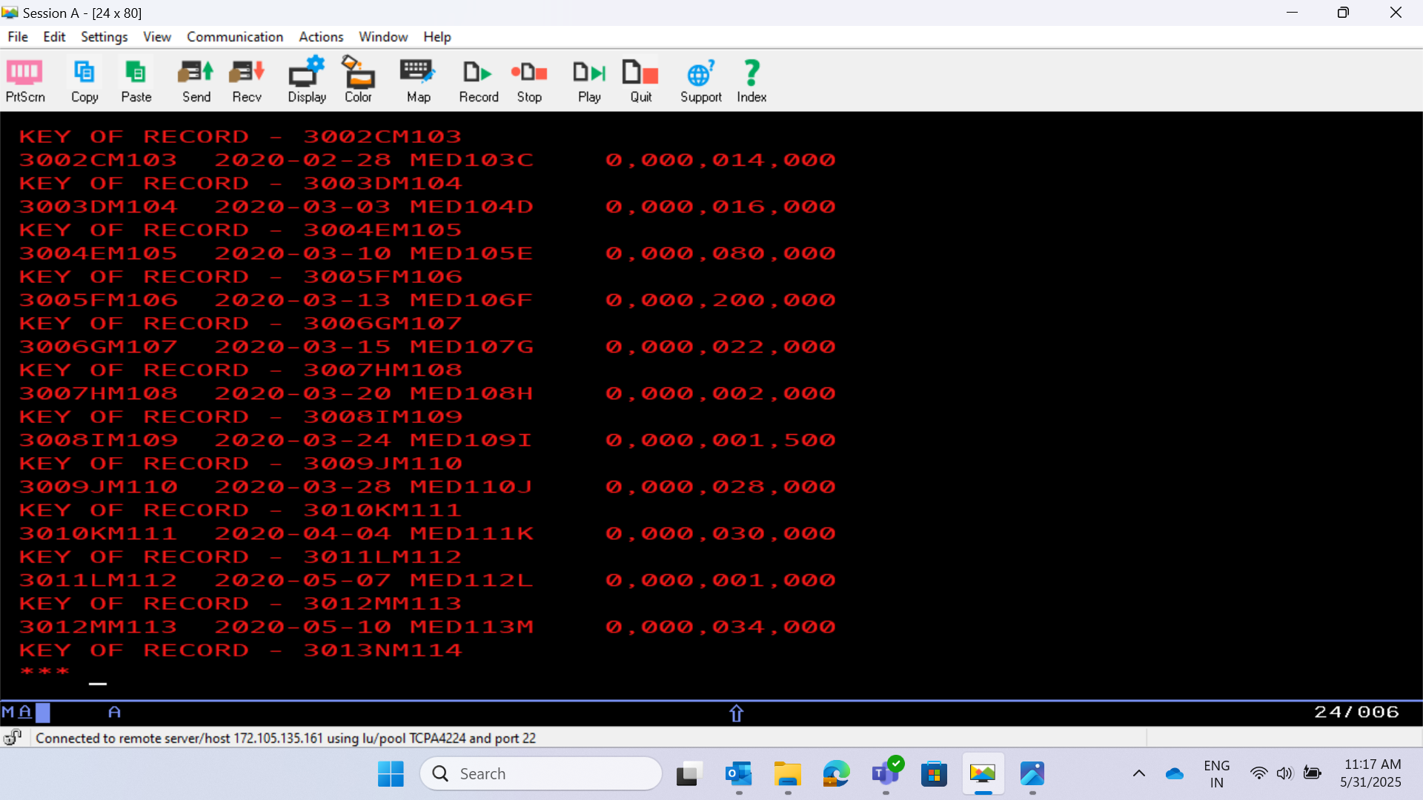

Slide 27
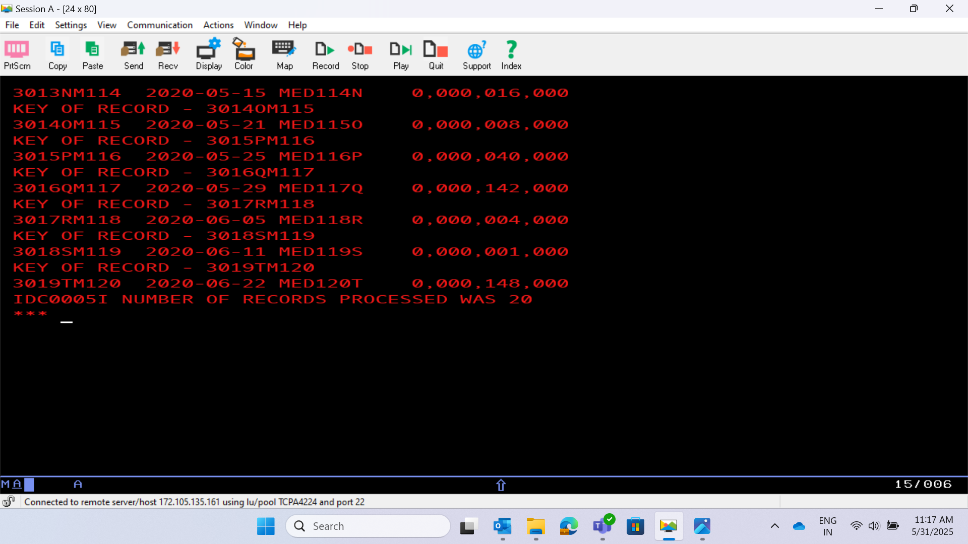

Slide 28
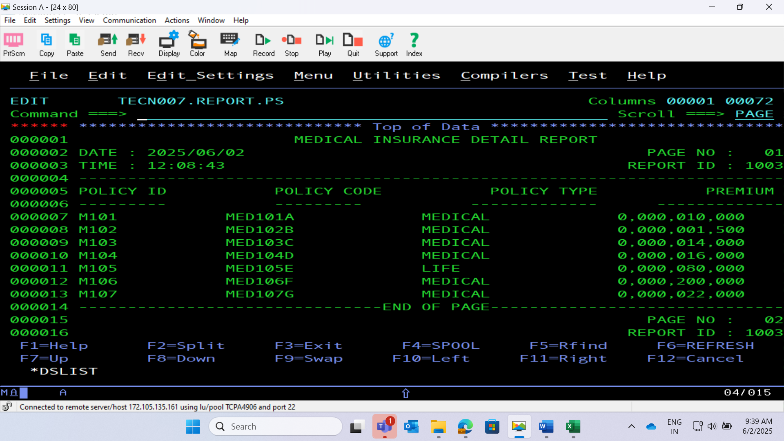
PROJECT REPORT

Slide 29
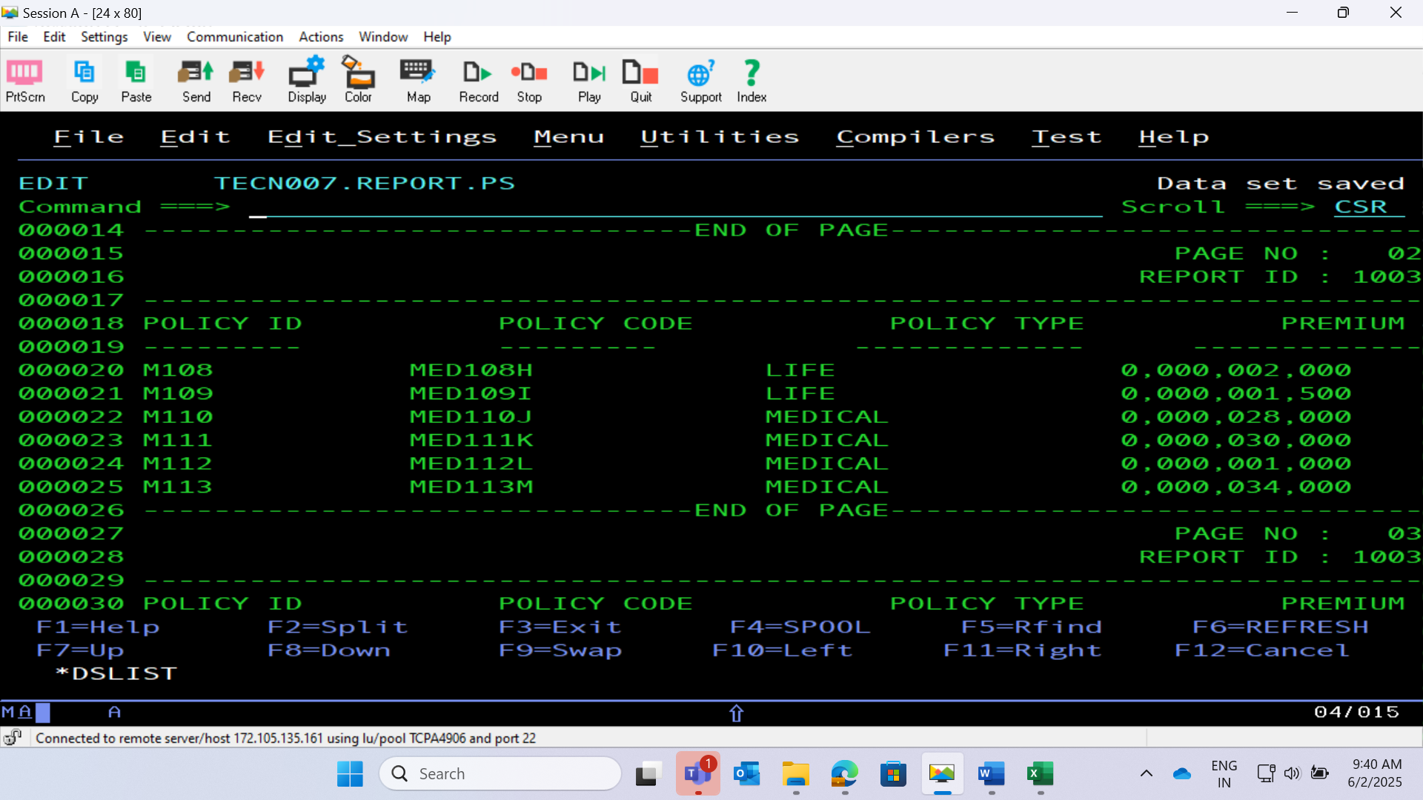

Slide 30
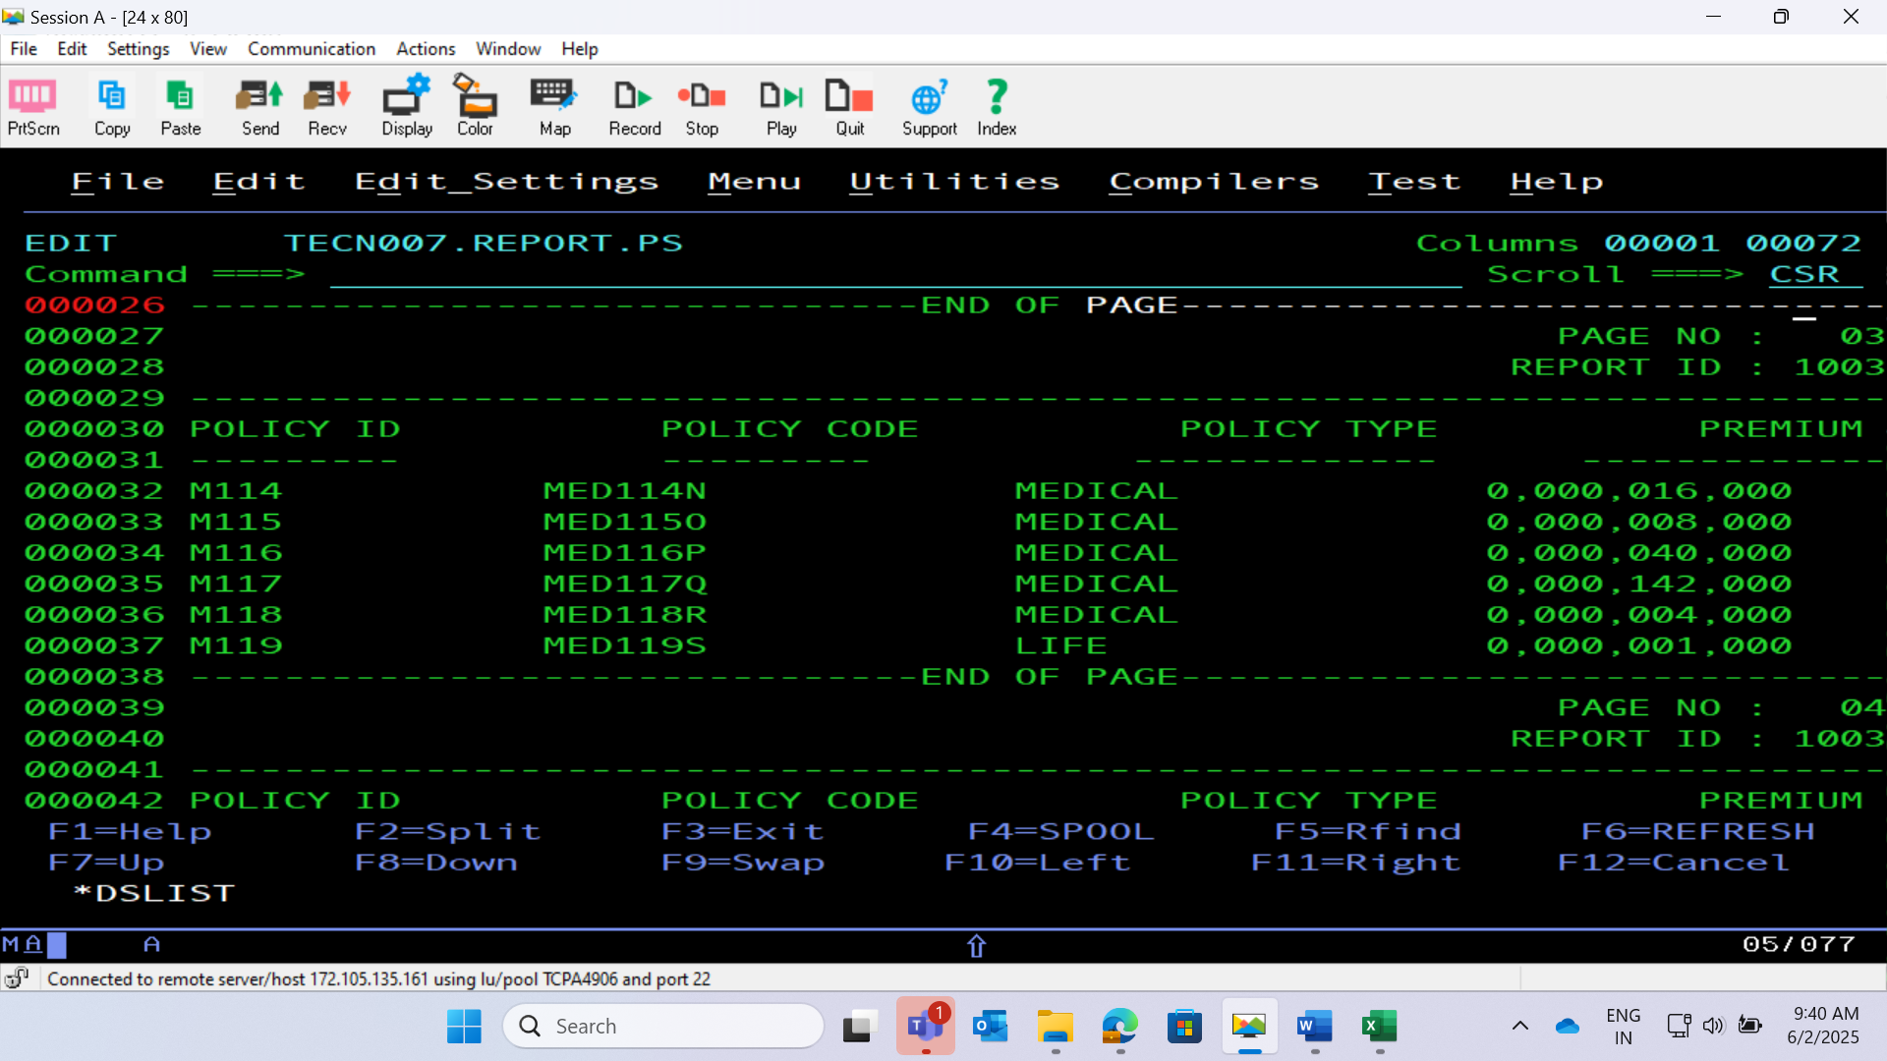

Slide 31
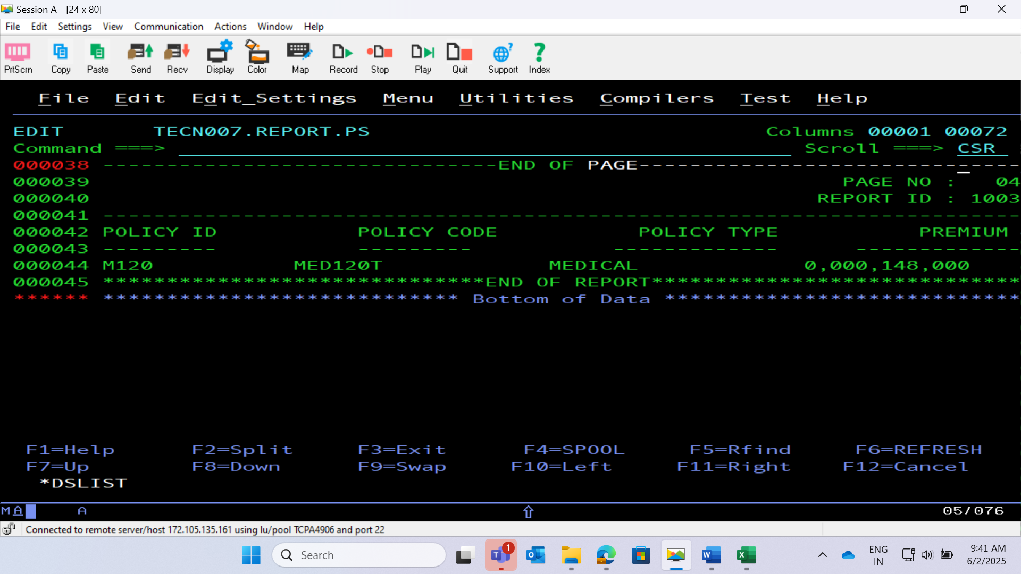

Slide 32
THANK YOU !

